Slide 1
Find the Best Sushi Restaurant in NYC
Capstone Project - The Battle of Neighbourhoods

Slide 2
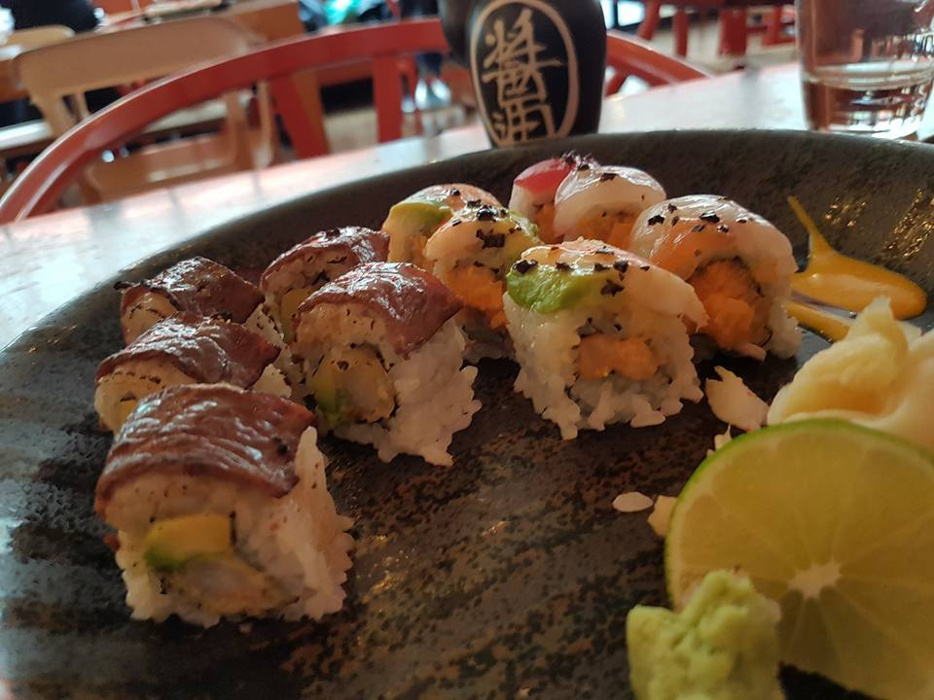
Introduction
My wife and I are big fans of Japanese cuisine, especially sushi. In every city we go, we have to try at least one sushi restaurant.
Sadly, my favourite sushi restaurant in NYC has been closed. In this project, I want to find the best sushi restaurant for us to visit on our next trip to NYC.

Slide 3
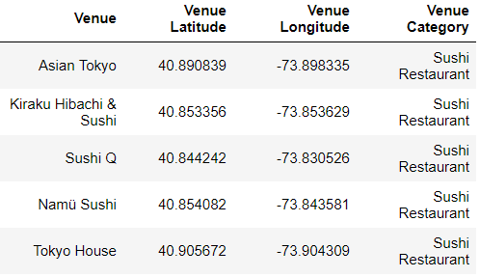
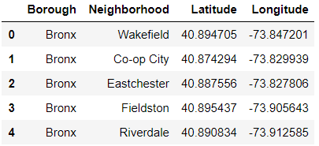
Data Sources
The following data is used in the project: 1 - Boroughs and Neighbourhoods in NYC: https://cocl.us/new_york_dataset 2 - Sushi restaurants from Foursquare API

Slide 4
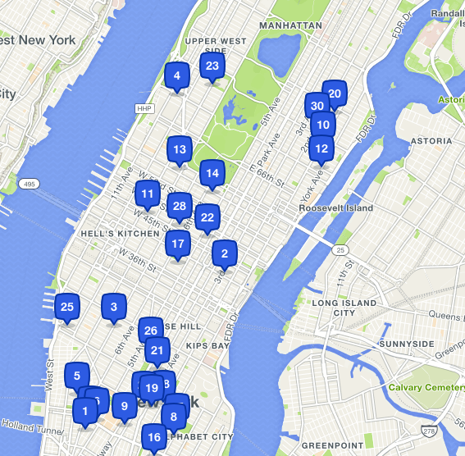
Methodology
I will analyse and visualize the data to find the best restaurant. I will collect data from foursquare that include ratings for the restaurants to help me in the selection process.

Slide 5

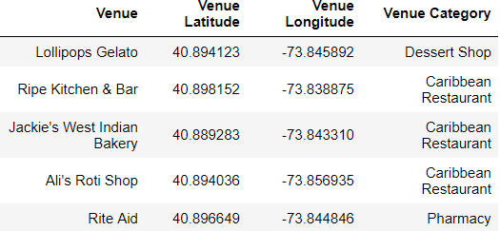
Data Analysis
First, collect all venues in NYC
results = requests.get(url).json()["response"]['groups'][0]['items']

Slide 6
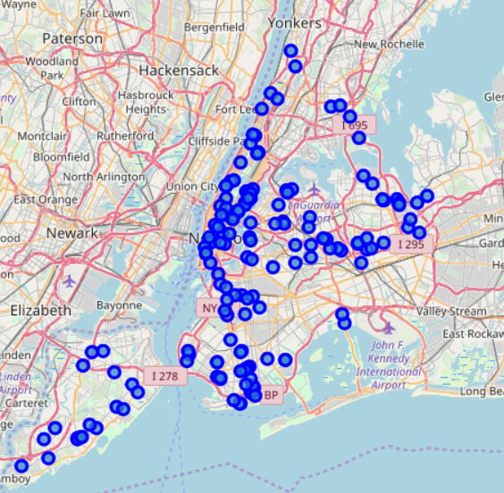
Data Analysis (cont.)
Next, select sushi restaurants only
sushi_rest = ny_venues[ny_venues['Venue Category']=="Sushi Restaurant"]

Slide 7
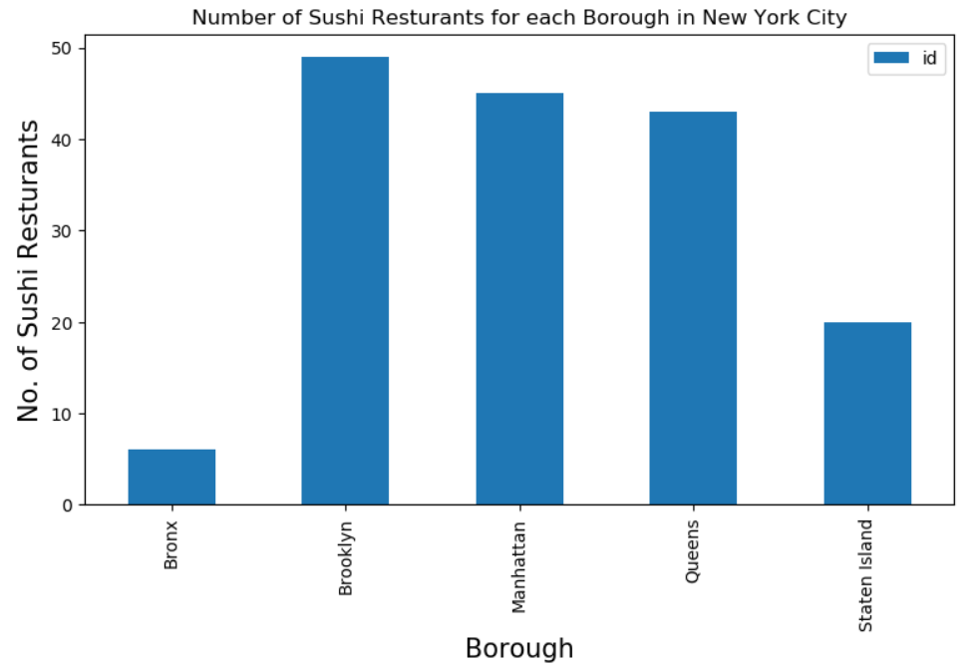
Data Analysis (cont.)
Let's see how many restaurants are there by Borough

Slide 8
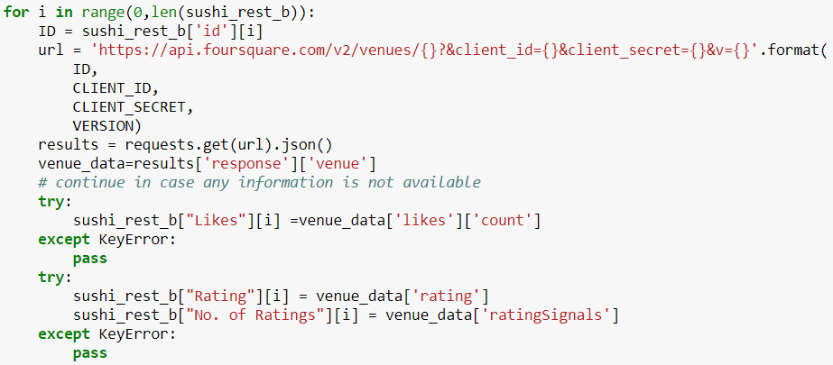
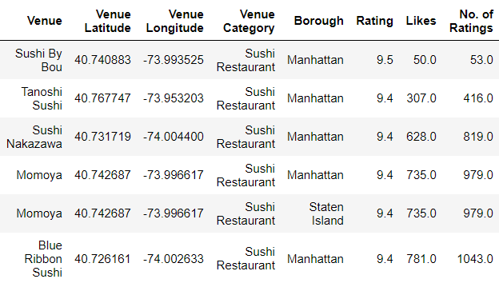
Data Analysis (cont.)
Now I will collect the ratings from Foursquare

Slide 9
Results
To help decide which restaurants to choose, I will filter the data by the highest rated ones only
The results show that there are 74 restaurants.
Too many, let’s do additional analysis
sushi_rest_hr = sushi_rest_b[sushi_rest_b['Rating'] >=8.0]

Slide 10
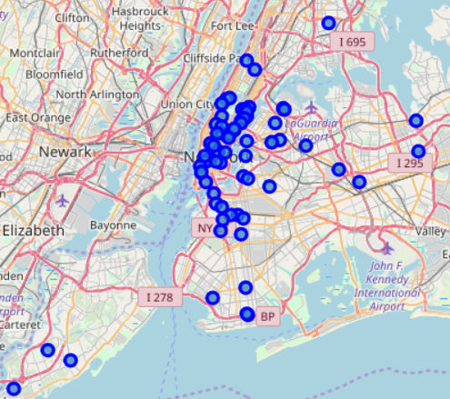
Results (Cont.)
To help decide which restaurants to choose, I will filter the data by the highest rated ones only
The results show that there are 74 restaurants.
Too many, let’s do additional analysis
sushi_rest_hr = sushi_rest_b[sushi_rest_b['Rating'] >=8.0]

Slide 11
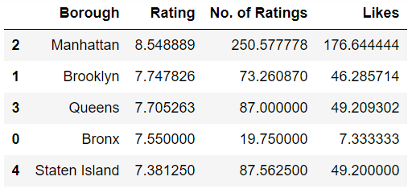
Results (Cont.)
Let’s look at the average rating in each borough

Slide 12
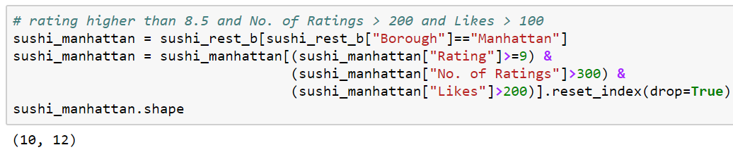
Discussion
The data shows that Manhattan has the best sushi restaurants
Let's narrow down the search to high rated restaurants in Manhattan
Now I have 10 restaurants to choose from

Slide 13
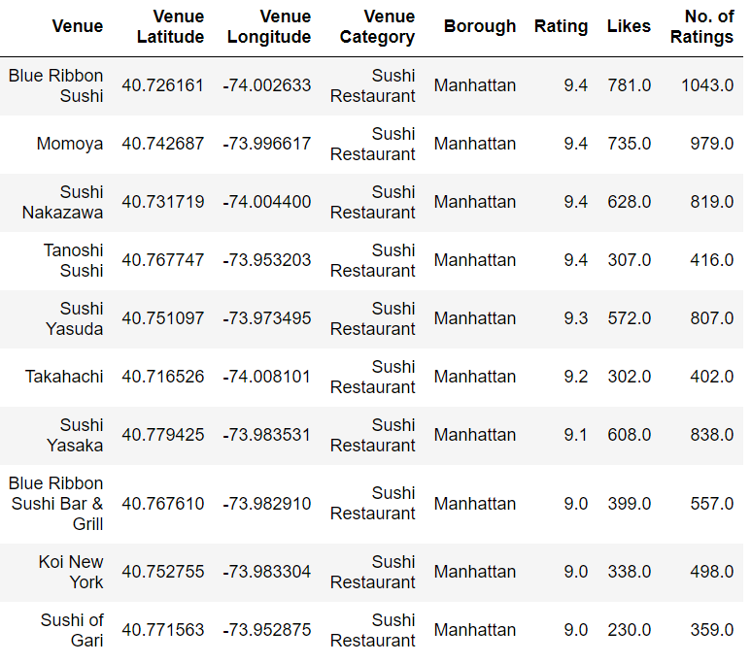
Discussion (cont.)
Blue Ribbon Sushi has the highest score

Slide 14
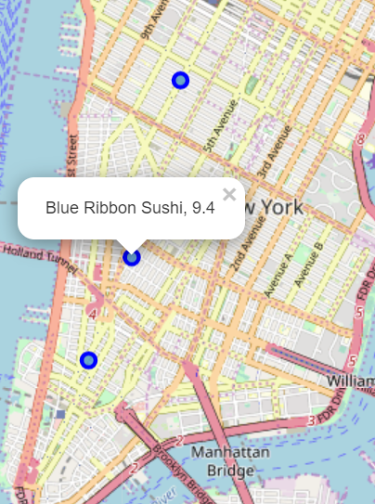
Conclusion
Manhattan has many high quality sushi restaurants. I chose Blue Ribbon Sushi based on the rating, number of users who rated the restaurant, and number of likes.
I will be going to this restaurant in the summer

